Slide 1

Our gene data
Oscar reuda
Cambridge research institute

Slide 2
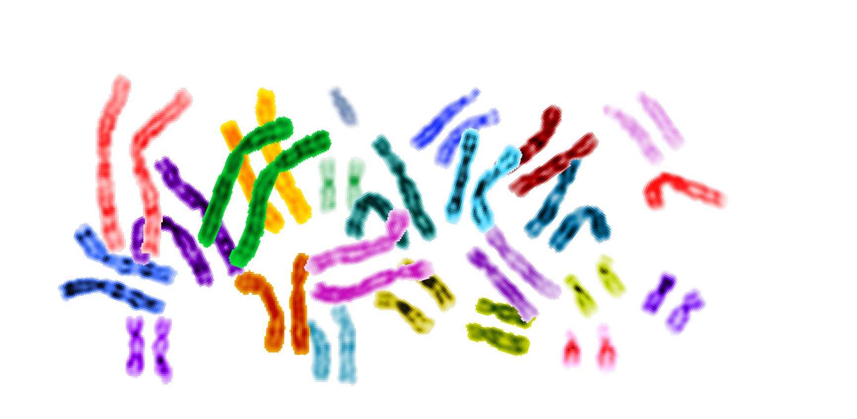
A HEALTHY GENOME HAS *TWO COPIES OF EACH CHROMOSOME
Picture source: http://www.genome-engineering.com/

Slide 3

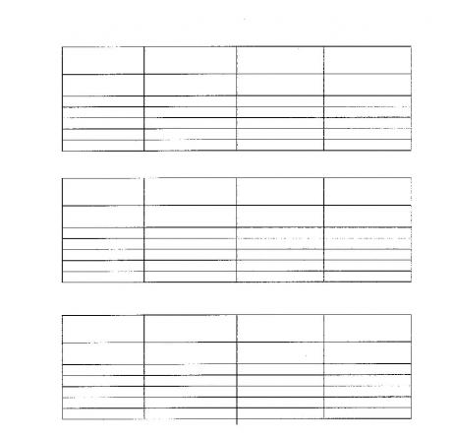

HELICOPTER VIEW OF CELL BIOLOGY
DNA contains
genes
Genes are factories to generate RNA
RNA gives template for proteins
Proteins do things
If we lose one or both copies of a factory, we lose the ability to do that ‘thing’ (e.g. kill cells that look like cancer)
If we gain an extra factory or five, we might do it a bit too much (e.g. grow)

Slide 4
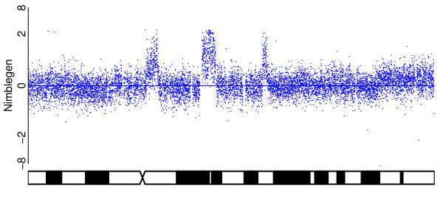
GENE DATA TYPICALLY LOOKS LIKE THIS
The challenge is to spot the points at which copy number changes

Slide 6
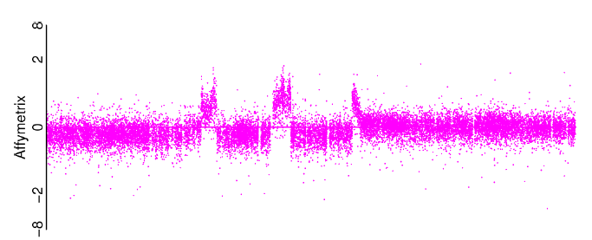
SEGMENTATION OF GENE DATA
The minimal copy number data from a microarray can be represented as…
Probe strength (relative to a normal sample)
Known position in genome

Slide 7
SEGMENTATION OF GENE DATA
We want to identify the change-points as accurately as possible
Probe strength (relative to a normal sample)

Slide 8
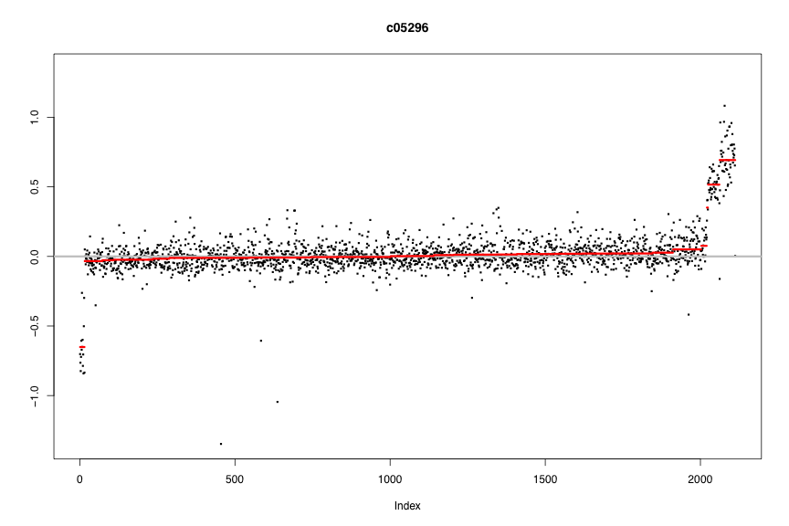
SECOND TASK: COPY NUMBER CALLING
SECOND TASK: COPY NUMBER CALLING
GAIN
LOSS

Slide 9
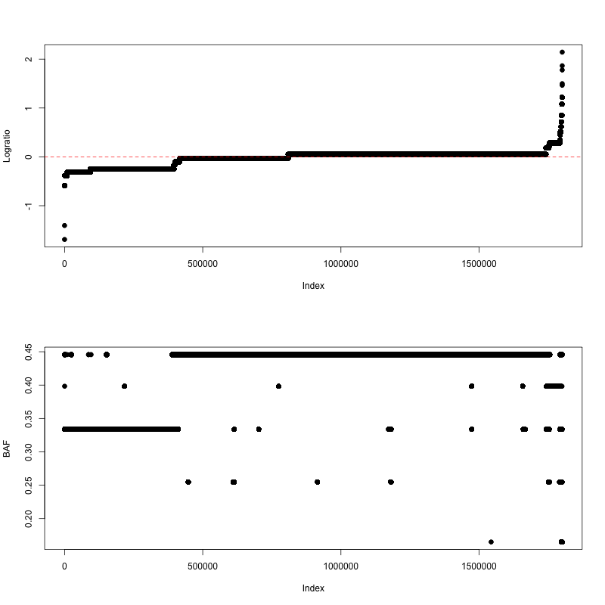
SECOND TASK : COPY NUMBER CALLING

Slide 10
DATA FORMAT
The gene data will consist of a probe name, co-ordinates in the genome, and intensity value for each probe
Be aware that there are different versions of the human genome out there. The first data set is aligned to “hg18”
See (for example) http://genome.ucsc.edu/cgi-bin/hgTables?command=start for other information that could be displayed alongside the microarray data
I have been using “IGV” to view the data

Slide 11
WHAT DO WE HOPE TO ACHIEVE
Citizen Scientists will help us pin down exactly where the changes are occurring
This may lead to a better understanding of the mechanism that drives copy number change
We may also spot localised changes that were invisible to other technologies

